Slide 1

Final Software project
By Daniel King
CST499 – Charmelia Butler
6/30/25

Slide 2

AGENDA
Overview – SRS document
Uml designs
Design – Landing, login, enrollment
Sql database and class registration
Php code

Slide 3
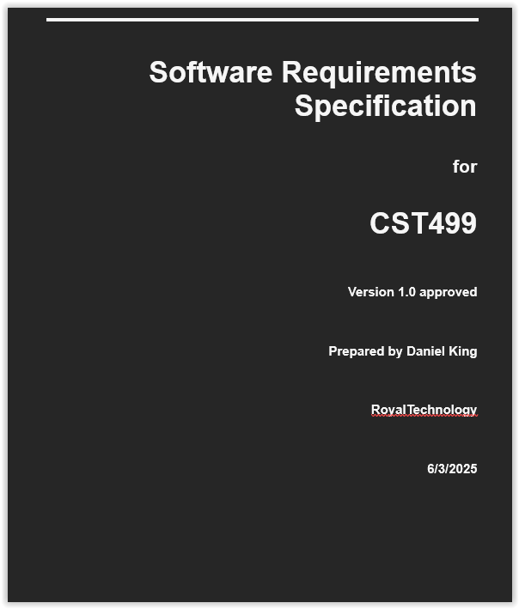
SRS Document
Table of Contents
Introduction – Purpose, Audience, and Scope
Description – Features, Classes, OS, Design, Dependencies
System Features – User creation & Class Management
External Interfaces – User, Hardware, Software, Communications
Glossary

Slide 4
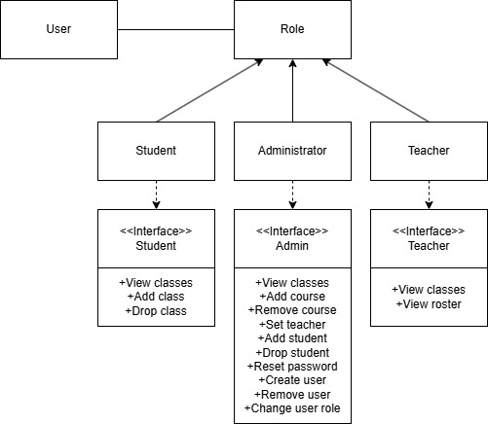
UML Class Model
This model demonstrates the various classes of user that would exist in the finalized product.
For the prototype, only the student class and view has been created.
This class lets the user view, add, and drop classes.

Slide 5
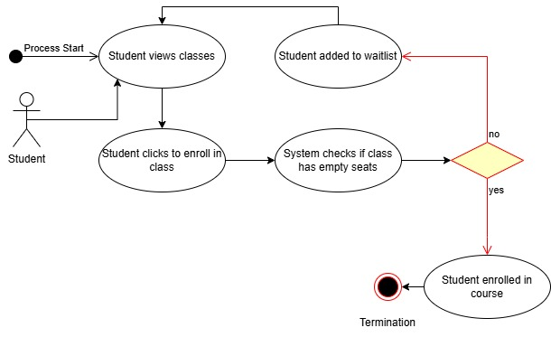
UML Enrollment Sequence
This model demonstrates the process of enrolling in a class.
The user views classes, and then selects ones to enroll in. If the class is not full, it adds the student to the class. Otherwise, it places them on a wait list.

Slide 6
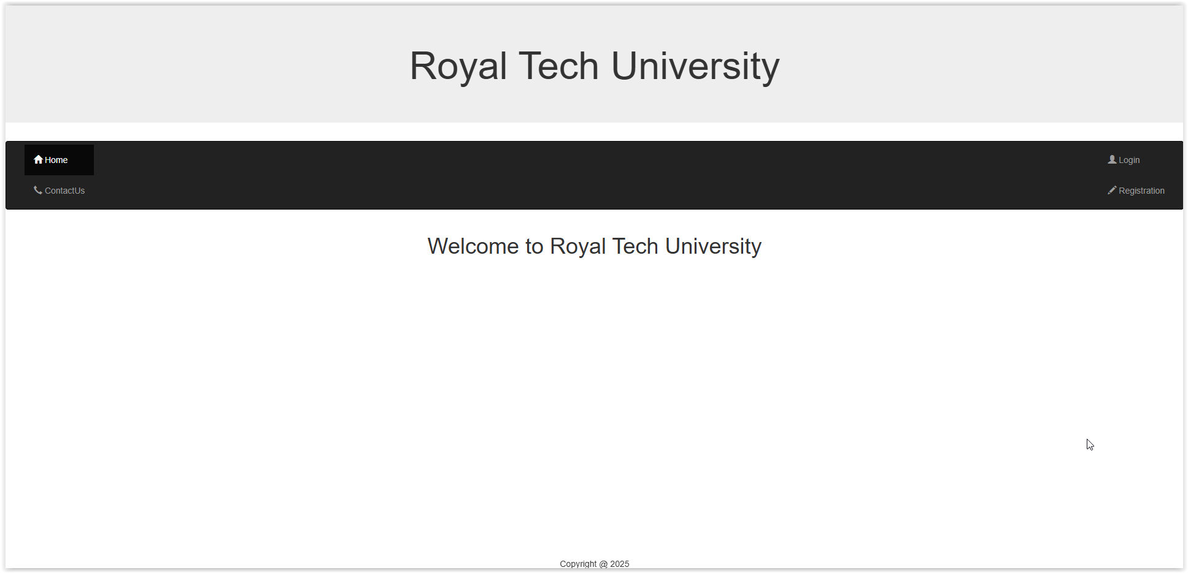
Landing Page

Slide 7
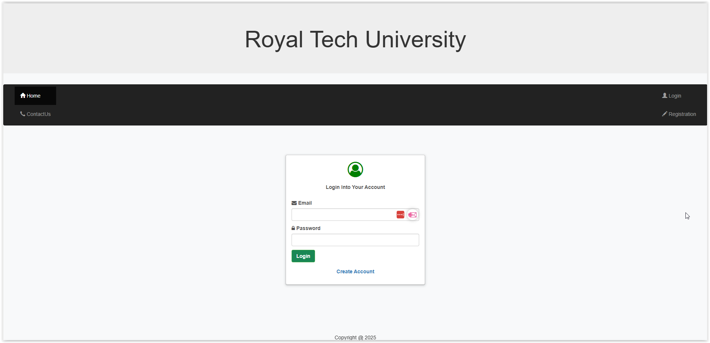
Login Page

Slide 8
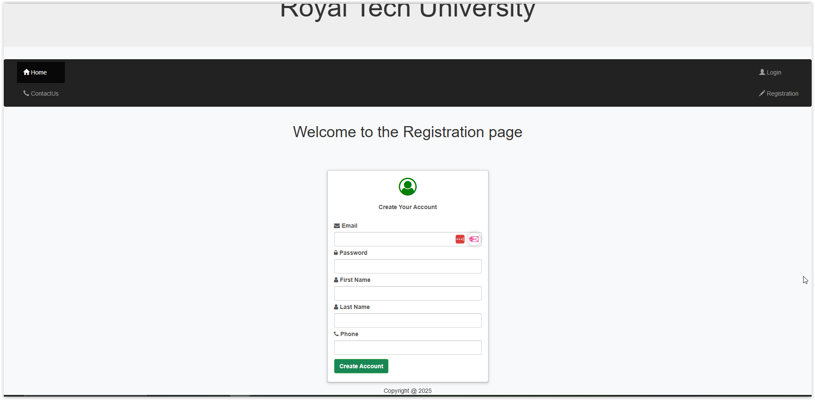
Enrollment Page

Slide 9
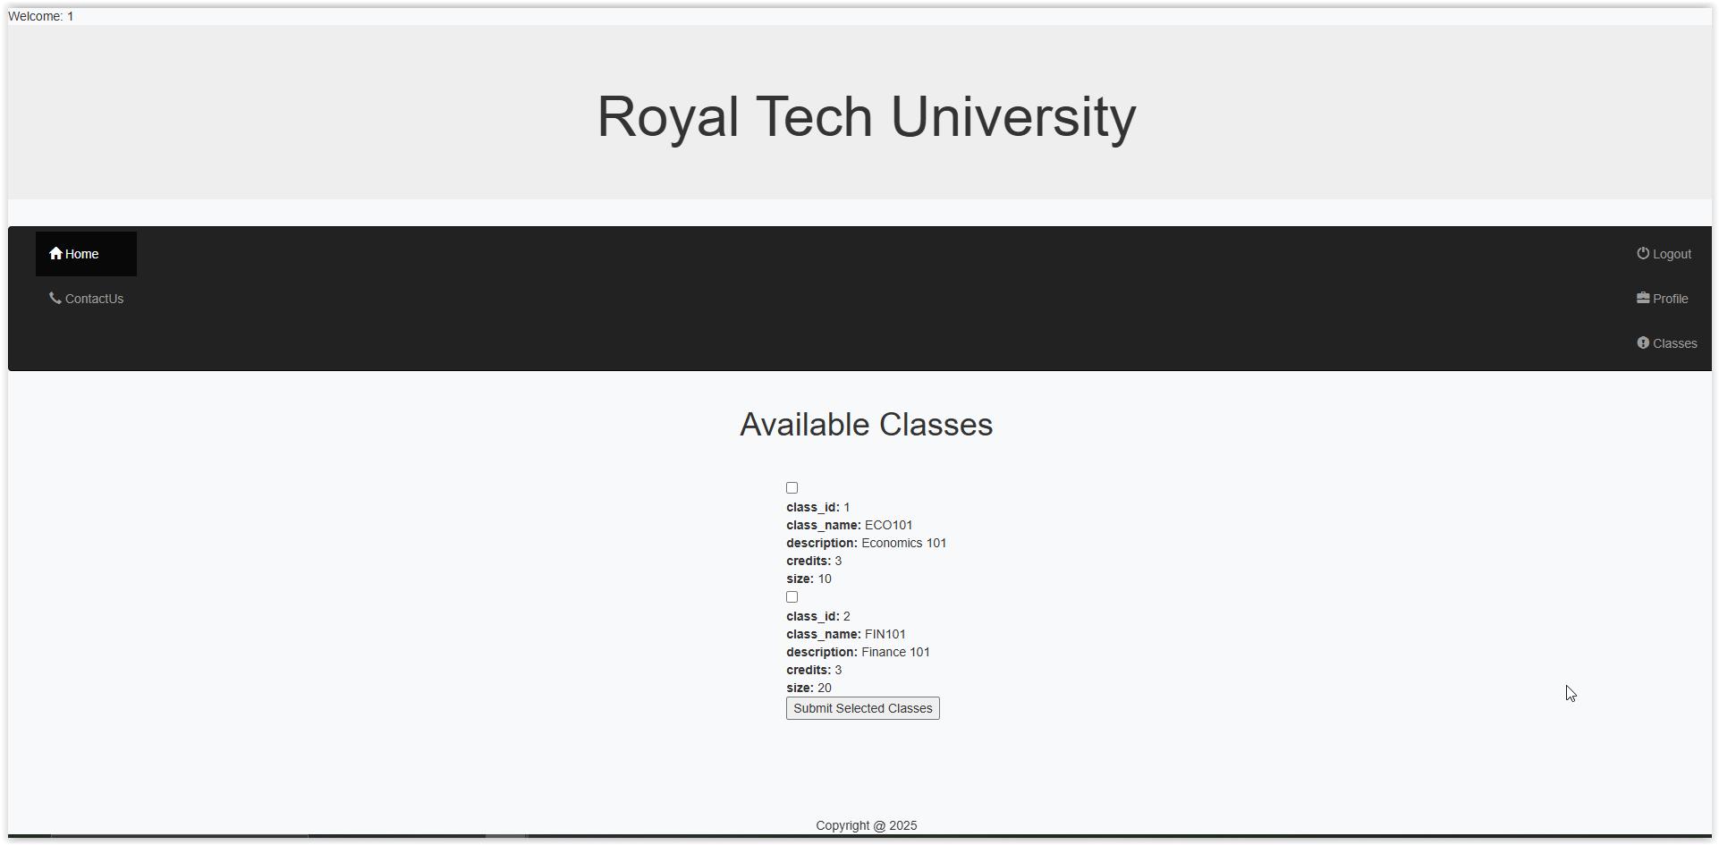
SQL and class registration

Slide 10
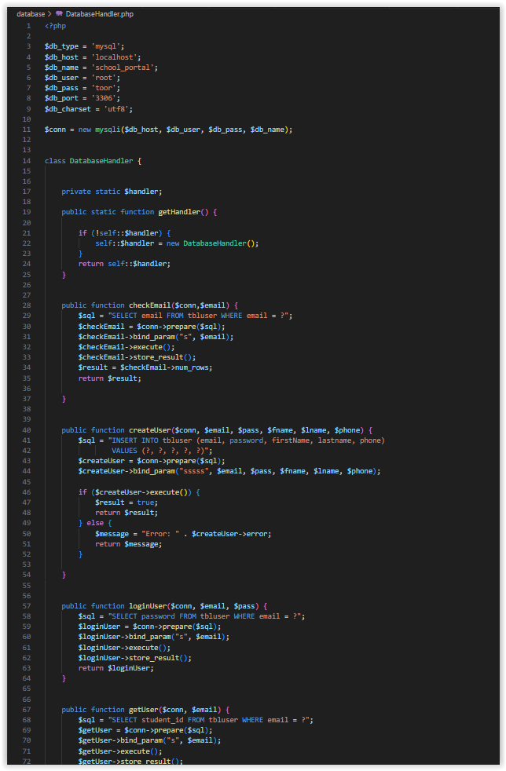
PHP Code
Database Handler for much of the database logic
Connection creation
User creation
Login
Pulling data
Validating email

Slide 11

THANK YOU

